Slide 1
Image Enhancement
To process an image so that the result is more suitable than the original image for a specific application.
Spatial domain methods and frequency domain methods.

Slide 2
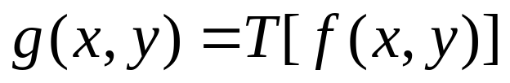
Spatial Domain Methods
Procedures that operate directly on the aggregate of pixels composing an image
A neighborhood about (x,y) is defined by using a square (or rectangular) subimage area centered at (x,y).

Slide 3
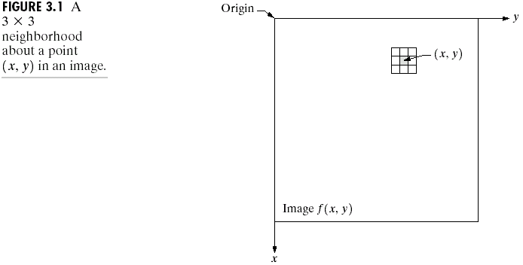
Image Enhancement in the
Spatial Domain

Slide 4
Spatial Domain Methods
When the neighborhood is 1 x 1 then g depends only on the value of f at (x,y) and T becomes a gray-level transformation (or mapping) function:
s=T(r)
r,s: gray levels of f(x,y) and g(x,y) at (x,y)
  Point processing techniques (e.g. contrast stretching, thresholding)

Slide 5
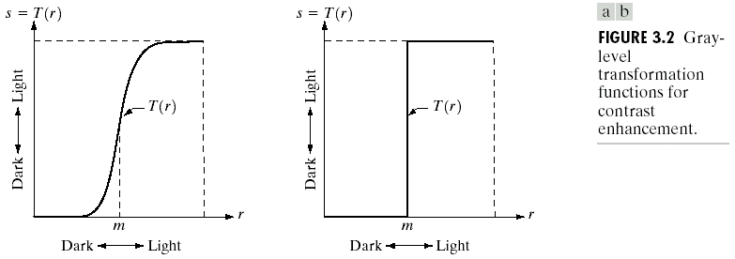
Image Enhancement in the
Spatial Domain
Contrast Stretching
Thresholding

Slide 6
Spatial Domain Methods
Mask processing or filtering: when the values of f in a predefined neighborhood of (x,y) determine the value of g at (x,y).
  Through the use of masks (or kernels, templates, or windows, or filters).

Slide 7
Enhancement by
Point Processing
These are methods based only on the intensity of single pixels.
  r denotes the pixel intensity before processing.
  s denotes the pixel intensity after processing.

Slide 8
Some Simple
Intensity Transformations
Image negatives
Piecewise-Linear Transformation Functions:
  Contrast stretching
  Gray-level slicing
  Bit-plane slicing
Implemented via Look-Up Tables (LUT) where values of T are stored in a 1-D array (for 8-bit, LUT will have 256 values)

Slide 9
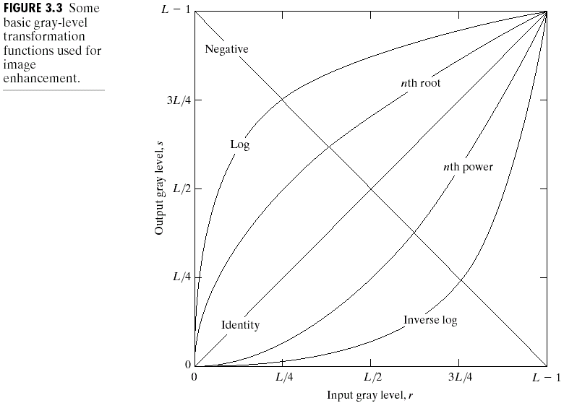
Image Enhancement in the
Spatial Domain
Linear: Negative, Identity
Logarithmic: Log, Inverse Log
Power-Law: nth power, nth root

Slide 10
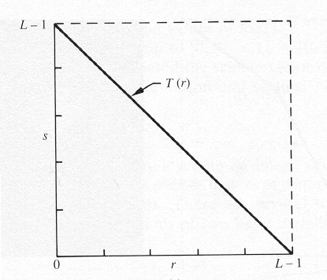
Image Negatives
Are obtained by using the transformation function s=T(r).
[0,L-1] the range of gray levels
S= L-1-r

Slide 11
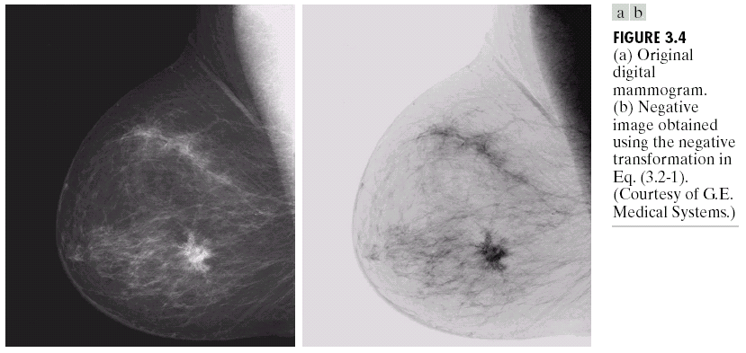
Image Enhancement in the
Spatial Domain

Slide 12
Image Negatives
Function reverses the order from black to white so that the intensity of the output image decreases as the intensity of the input increases.
Used mainly in medical images and to produce slides of the screen.

Slide 13
Log Transformations
s = c log(1+r)
c: constant
Compresses the dynamic range of images with large variations in pixel values

Slide 14
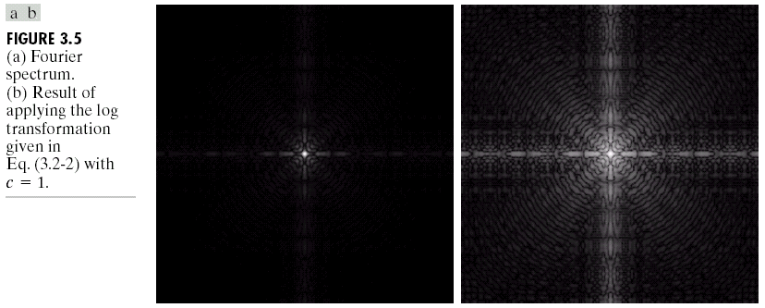
Image Enhancement in the
Spatial Domain

Slide 15
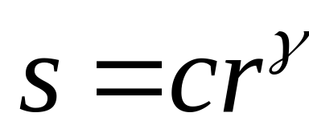
Power-Law Transformations
C, γ : positive constants
Gamma correction

Slide 16
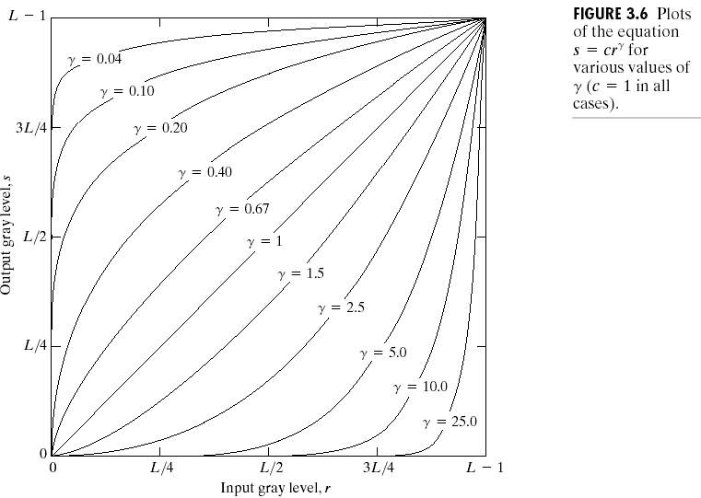
Image Enhancement in the
Spatial Domain
γ=c=1: identity

Slide 17
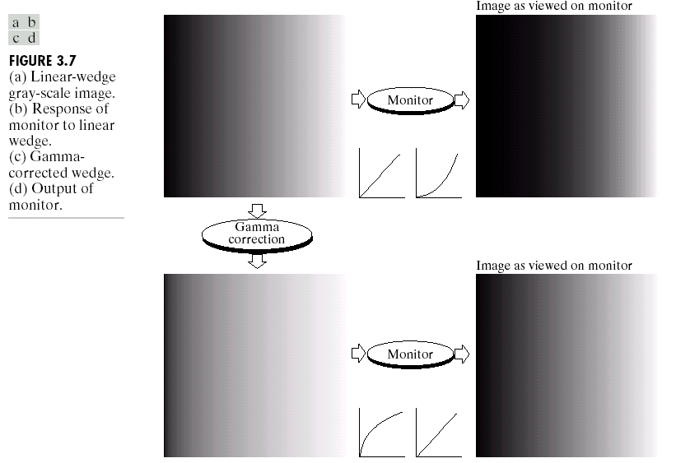
Image Enhancement in the
Spatial Domain

Slide 18
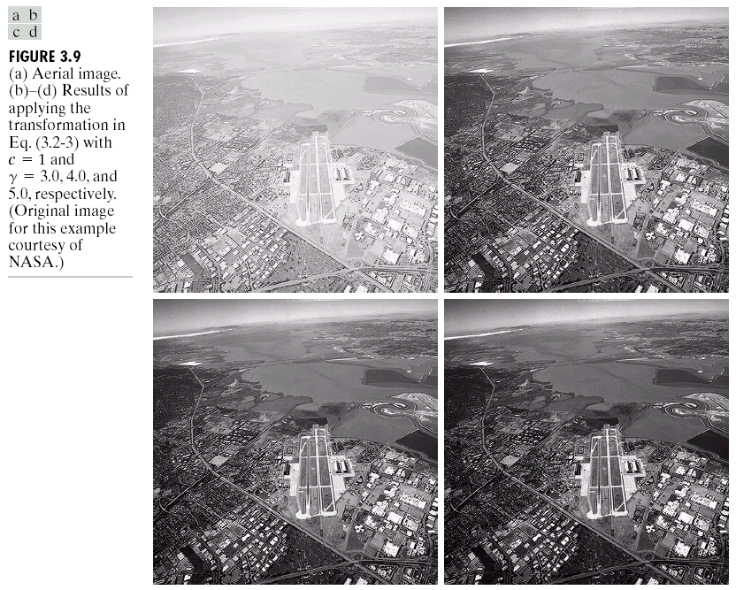
Image Enhancement in the
Spatial Domain

Slide 19
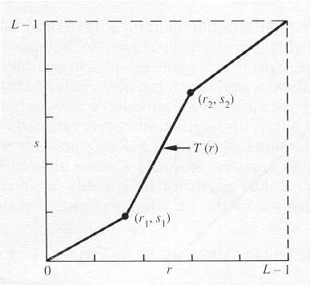
Piecewise-Linear Transformation Functions
Contrast Stretching
To increase the dynamic range of the gray levels in the image being processed.

Slide 20
Contrast Stretching
The locations of (r₁,s₁) and (r₂,s₂) control the shape of the transformation function.
  If r₁= s₁ and r₂= s₂ the transformation is a linear function and produces no changes.
  If r₁=r₂, s₁=0 and s₂=L-1, the transformation becomes a thresholding function that creates a binary image.

Slide 21
Contrast Stretching
More on function shapes:
  Intermediate values of (r₁,s₁) and (r₂,s₂) produce various degrees of spread in the gray levels of the output image, thus affecting its contrast.
  Generally, r₁≤r₂ and s₁≤s₂ is assumed.

Slide 22

Image Enhancement in the
Spatial Domain

Slide 23
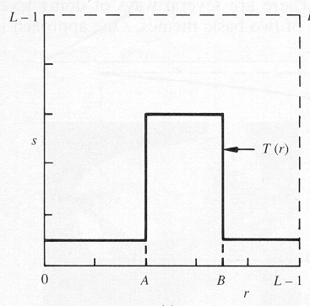
Gray-Level Slicing
To highlight a specific range of gray levels in an image (e.g. to enhance certain features).
One way is to display a high value for all gray levels in the range of interest and a low value for all other gray levels (binary image).

Slide 24
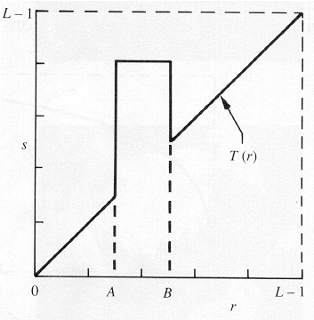
Gray-Level Slicing
  The second approach is to brighten the desired range of gray levels but preserve the background and gray-level tonalities in the image:

Slide 25
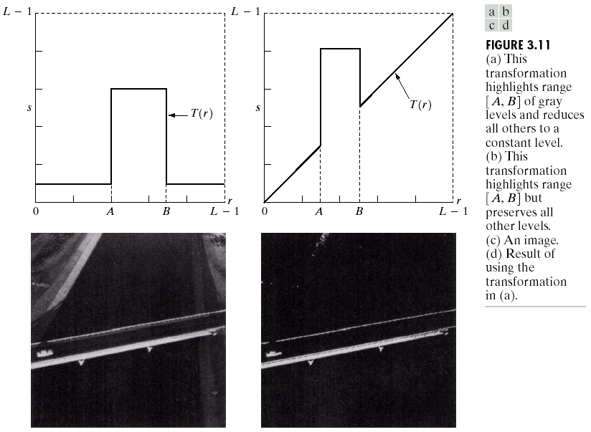
Image Enhancement in the
Spatial Domain

Slide 26
Bit-Plane Slicing
To highlight the contribution made to the total image appearance by specific bits.
  i.e. Assuming that each pixel is represented by 8 bits, the image is composed of 8 1-bit planes.
  Plane 0 contains the least significant bit and plane 7 contains the most significant bit.

Slide 27
Bit-Plane Slicing
More on bit planes:
  Only the higher order bits (top four) contain visually significant data. The other bit planes contribute the more subtle details.
  Plane 7 corresponds exactly with an image thresholded at gray level 128.

Slide 28
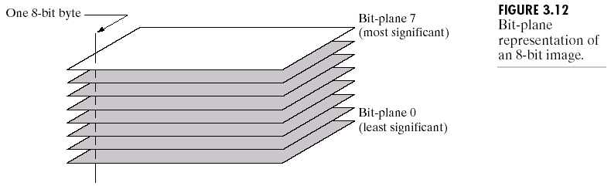
Image Enhancement in the
Spatial Domain

Slide 29
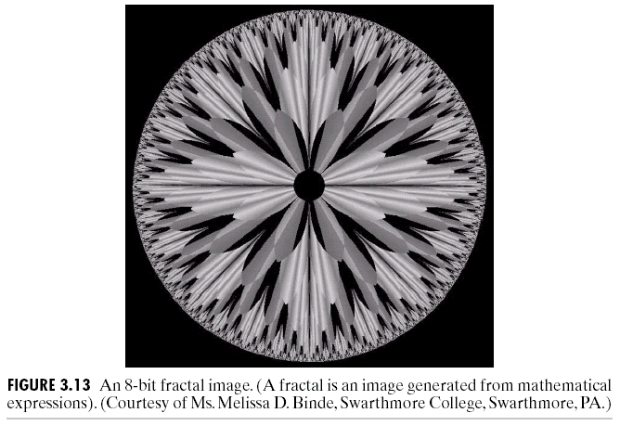
Image Enhancement in the
Spatial Domain

Slide 30
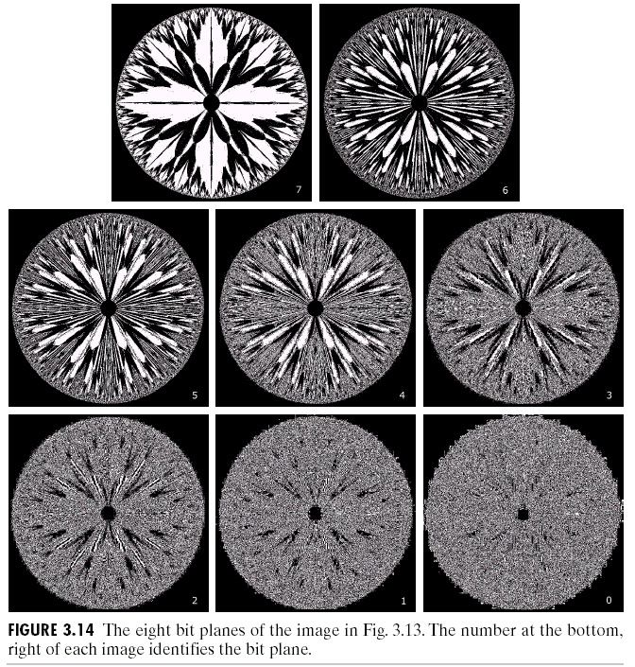
Image Enhancement in the
Spatial Domain

